Slide 1
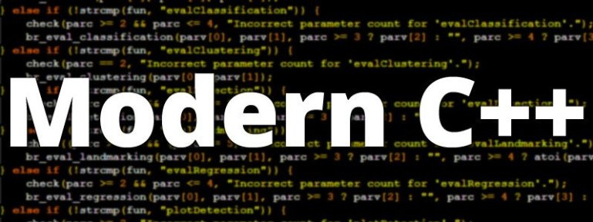
ADVAnce C++

Slide 2
MODERN C++
Introduction To STL
What problem STL solves ?
Components Of STL
History Of STL

Slide 3
Introduction to STL
The C++ STL (Standard Template Library) is a powerful set of predefined classes.
These classes are implementations of some very popular data structures like vectors, arrays, stacks, linked list ,queue etc.

Slide 4
Introduction to STL
Moreover these classes contain predefined methods also which makes it very easy for a programmer to use these data structures in his program
Another point to remember about these classes is that they are template based classes, which means that they can work with collection of any type of data

Slide 5
what problem DOEs stl solve ?
Write a program which continuously accepts numbers from the user and as soon as 0 is entered it should display all the numbers inputted

Slide 6
what problem DOES stl solve ?
Can we design this code using an array ?
No, we cannot design this code using array , since we don’t know the array size.

Slide 7
solution
So STL provides us a class called vector which we can use in such situations .
It is similar to an array but the specialty is that it automatically handles its own storage requirements in case it grows or shrinks

Slide 8
Components of stl
Component | Description
Containers | Containers are used to store a collections of data of a certain type. There are several different types of containers like vector, list, dequeue, array , map etc.
Algorithms | Algorithms act on containers. They provide the means by which you will perform initialization, sorting, searching, and transforming of the contents of containers.
Iterators | Iterators are used to step through the elements of a container.

Slide 9
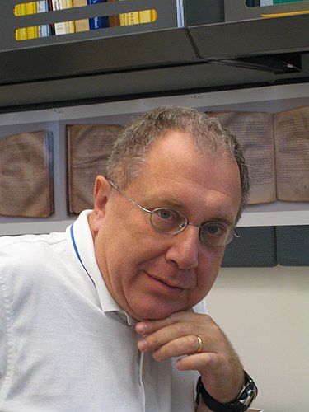

History OF STL
The primary designer and implementor of STL is Alexander Stepanov.
He started working on STL at HP in 1992 and was later joined by Meng Lee.

Slide 10
History OF STL
In 1993 they submitted their work to ISO-C++ committee for review and approval.
In 1994 the ISO committee accepted STL and announced that it will be included in the language itself

